Slide 1
AI for Mobile Robots - CSIP5202: Unit 2 Intelligent Mobile Robots (IMR)
Lesson 1 Introduction

Slide 2
Who am I?
Dr. Aboozar Taherkhani
Email: Aboozar.taherkhani@dmu.ac.uk

Slide 3
Overview
Introduction
Teaching and Learning
Assessments
Doing well in this module
Maths Primer

Slide 4
Objectives
Understanding mathematical methods in robotics
Look at ways of mapping the environment
To understand how to localise a robot in the environment

Slide 5
Learning
1 Hours Lecture/2 Hours Practical (Group specific)
All to gather 10 lessons for IMR (based on your time table)
Asynchronous Lecture video on Learning Zone (LZ)
Finish the work from every lab
Any maths or Python help – let me know ASAP!
There are learning materials on LZ for introduction to Python

Slide 6
Thoughts?
This module is generally practical led – expect the lectures to be short, with more emphasis on the practical lab work.
The lab work follows the assessments – complete the lab work, and you’ll find the assessments easier.
Learn ROS development studio to run ROS
Get the software running on your home PC (if you like-optional).
Use the discussion board or other methods to help other students if they have problems with coding.

Slide 7
Assessment
1. Discussion Board and research (6%)
Discussion from content in the lecture and lab.
Aim to create a thread or reply to an existing thread for each Lesson.
2. Assignment 1(IMR): Mapping a 2D Environment (22%)
3. Assignment 2(IMR): Localisation of a known environment (22%)
Please see the specifications on LZ, I will discuss the assignment during practical.

Slide 8
Why Study Mobile Robots?
Job prospects in…
‣ Transport
‣ autonomous driving, taxis, buses
‣ self-driving market estimated at over $500 billion
‣ Warehouses and logistics
‣ E.g.: Amazon have doubled size of robot fleet in recent years
‣ Delivery services (e.g., Ocado, Uber Eats)
‣ Civilian and humanitarian
‣ search and rescue
‣ environmental monitoring
‣ force multiplication (military)
Notes:
Amanda Prorok, Mobile robot, systems, university of Cambridge

Slide 9
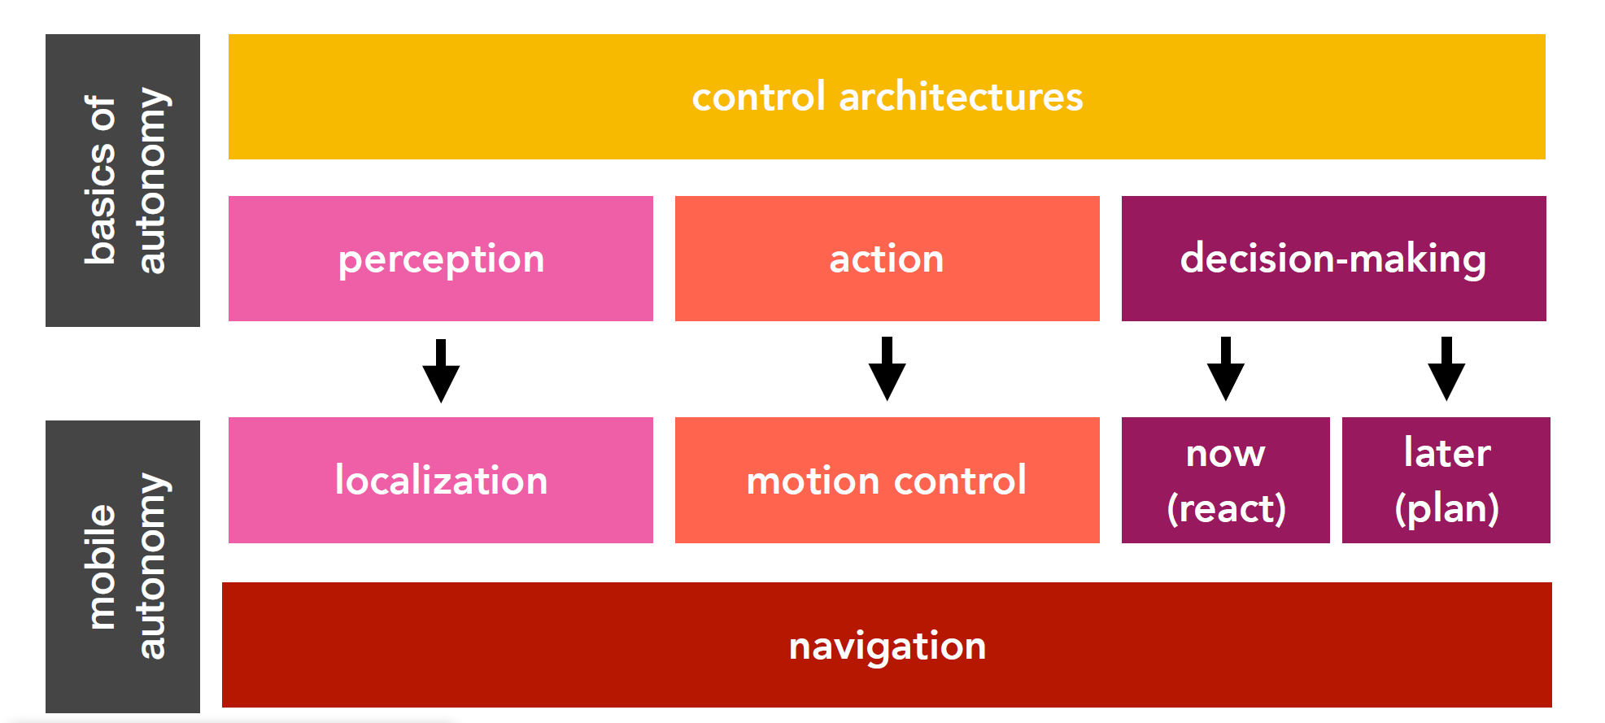
Autonomous mobile robots
In this course we focus on perception emphasise on mapping and localization
We learn about path planning
Notes:
Amanda Prorok, Mobile robot, systems, university of Cambridge

Slide 10
Learning Plan
Week | Subject
1 | Introduction
2 | Robot Operating System (ROS)
3 | Odometry
4 | Building a scattermap
5 | RANSAC (Random Sample Consensus )
6 | Occupancy Grids (1)
7 | Occupancy Grids (2)
8 | Particle Filters
9 | Localization 1
10 | Localization 2
Mobile Robot Video
https://www.youtube.com/watch?v=MX2qcDM11N4
Notes:
- Odometry is the use of motion sensors to determine the robot's change in position relative to some known position. For example, if a robot is traveling in a straight line and if it knows the diameter of its wheels, then by counting the number of wheel revolutions it can determine how far it has traveled.
Building a scatter map: How to build a simple map assuming the absence of uncertainty
RANSAC (Random Sample Consensus ) is a statistical method to fit a model to experimental data
Occupancy grid: How to build a map when there is uncertainty
https://www.youtube.com/watch?v=MX2qcDM11N4

Slide 11
Questions, queries or problems? Need Advice?
If it’s about the module, then please contact me!
During/after lectures
During/after lab sessions
By email (allow a few working days for a response)
Teams Online meeting
Ask from AI chat
Ask peers, your fellow students
The chances are if you are wondering about something, so is someone else and together you’ll find the answer
General queries (not just about this module)
CEM Advice Centre (Ground Floor, Gateway House)

Slide 12
Maths Primer
Lesson 1

Slide 13
Important
The maths here will be applied in this module
You will also need to code the maths
It is assumed you can handle basic algebra
If you struggle with this you must let me know!

Slide 14
Pythagoras Theorem
A² + B² = C²
Right-angled triangles
Hypotenuse is the longest side (C)
Robot moves 2.82m in x and -1.64m in y
How far has the robot moved?
C
A
B
Notes:
https://revisionmaths.com/gcse-maths-revision/trigonometry/pythagorass-theorem

Slide 15
Trigonometry
O
sin(θ) =
SOHCAHTOA
Robot moves from (4.3, -2.1) a distance of 3.19m at a heading of -27°
Where is the robot now?
H
A
cos(θ) =
H
H
O
O
θ
tan(θ) =
A
A
Notes:
https://www.khanacademy.org/math/geometry-home/right-triangles-topic/intro-to-the-trig-ratios-geo/v/basic-trigonometry

Slide 16
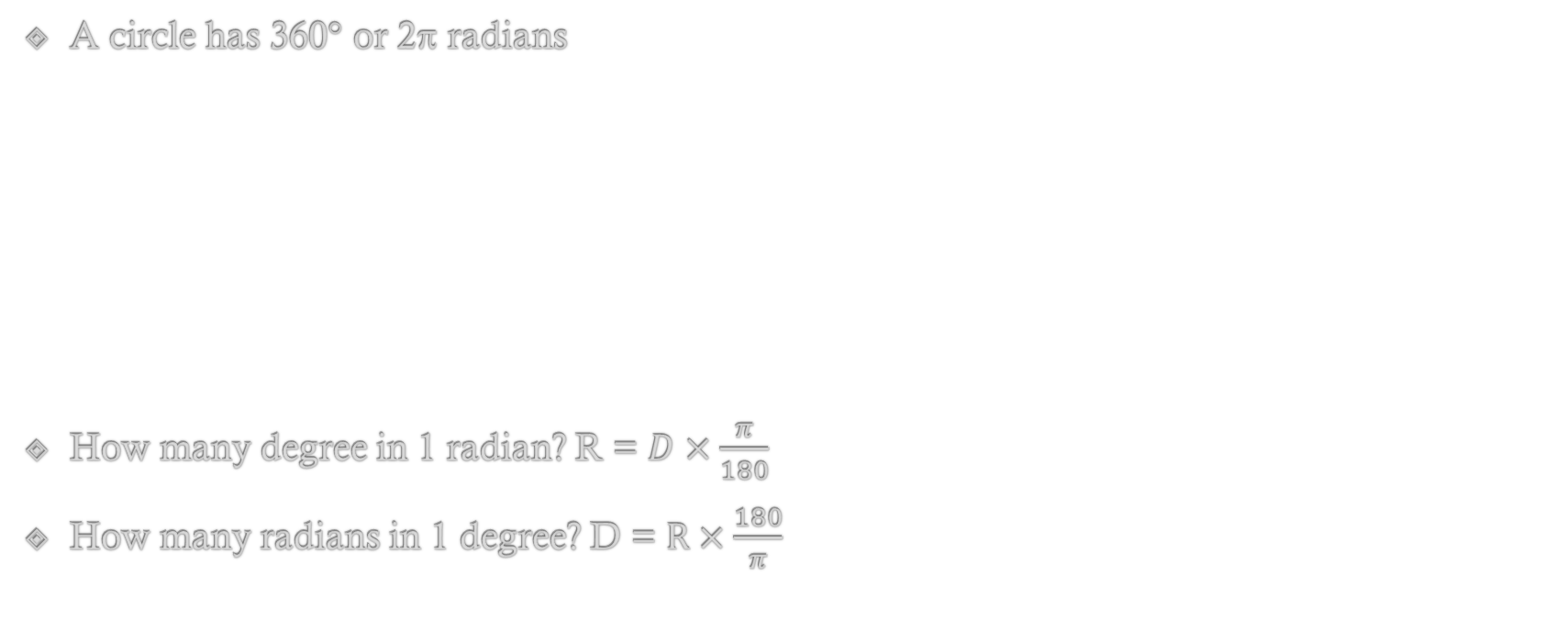
Degrees and Radians
A circle has 360° or 2π radians
How many degree in 1 radian? R = $D×\frac{π}{180}$
How many radians in 1 degree? D = $R×\frac{180}{π}$
2π
360°

Slide 17
Matrices
Addition
Multiplication
Dot product
a
c
a + c
b
+
=
d
b + d
a c
p
ap + cq
b d
X
q
=
bp + dq
a
c
b
∙
=a X c + b X d
d

Slide 18
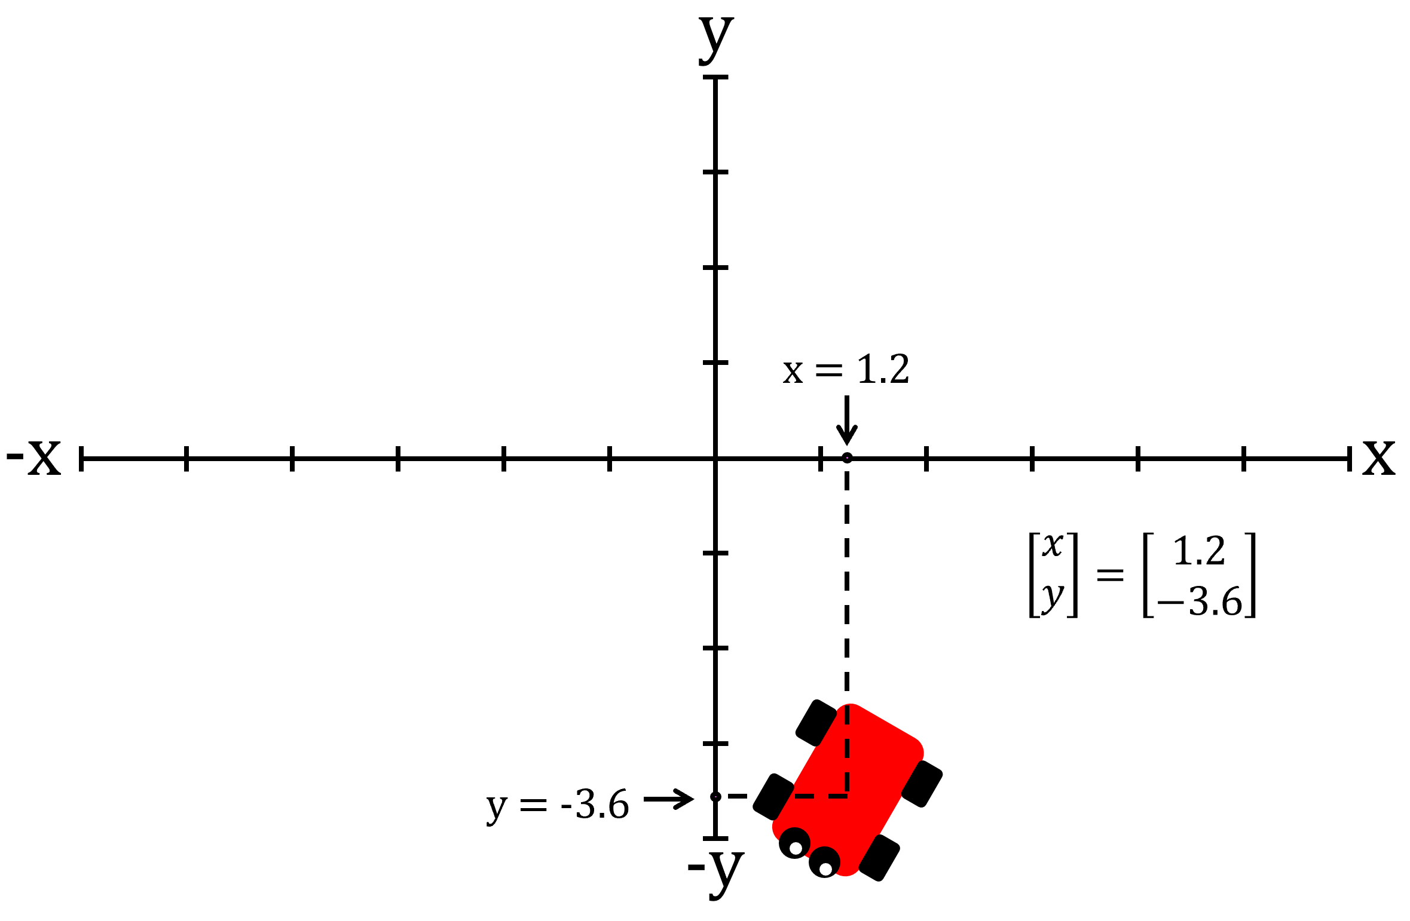
Matrices for Geometry
A position in 2D (Cartesian) space can be written as the matrix
Rotation (counter clockwise about the origin)
Robot moves from (2.1,1.9) to (3.1,1.6)
Given a compass error of +15° where is the robot really?
See examples on LZ (Week 1)
x
y
x'
cosθ -sinθ
x
=
sinθ cosθ
X
y
y'

Slide 19

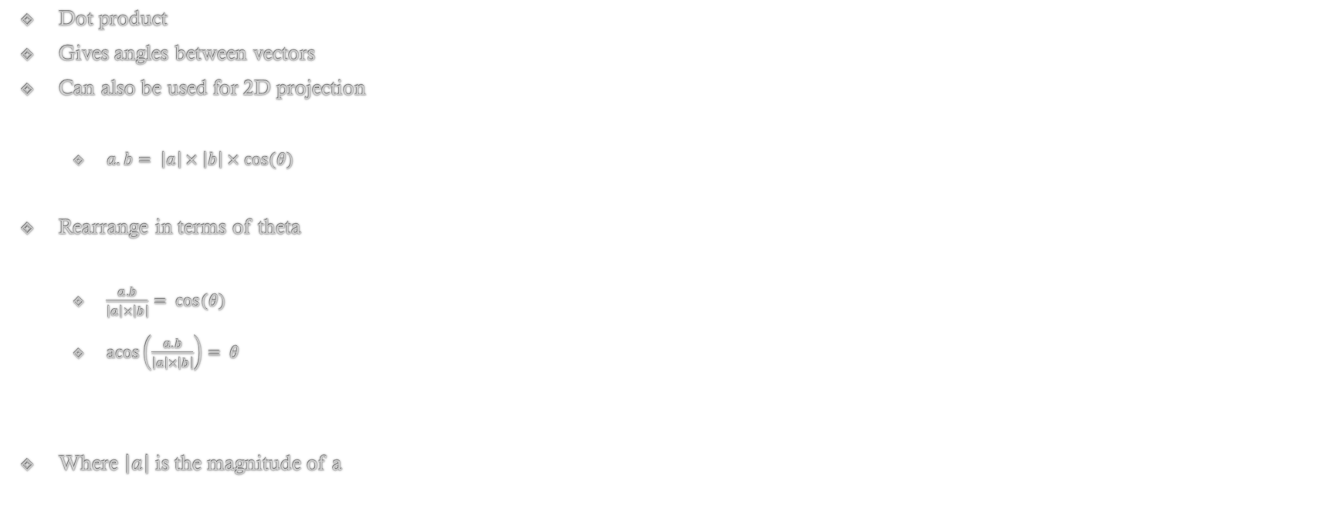


Matrices for Geometry
Dot product
Gives angles between vectors
Can also be used for 2D projection
$a.b= \left|a\right|×\left|b\right|×\cos{(θ)}$
Rearrange in terms of theta
$\frac{a.b}{\left|a\right|×\left|b\right|}= \cos{(θ)}$
$\operatorname{acos}\left(\frac{a.b}{\left|a\right|×\left|b\right|}\right)= θ$
Where $\left|a\right|$ is the magnitude of a
$$a$$
$$θ$$
$$b$$

Slide 20
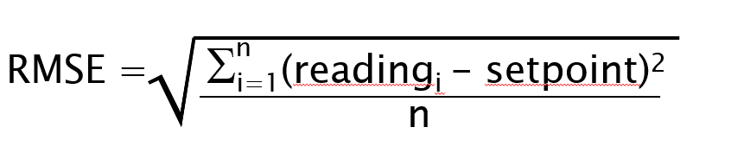
Root Mean Square Error (RMSE)
Common error measure for signals
Robot edge follower 250mm, readings:
Plot the data, calculate the RMSE
√
^{n}
n
i | 1 | 2 | 3 | 4 | 5 | 6 | 7 | 8 | 9 | 10
dist | 250 | 258 | 262 | 255 | 248 | 240 | 236 | 242 | 249 | 253

Slide 21
Linear Least Squares Estimate
Fits a straight line to a set of n points

Slide 22
Linear Least Squares Estimate
Fits a straight line to a set of n points
y = mx +c

Slide 23
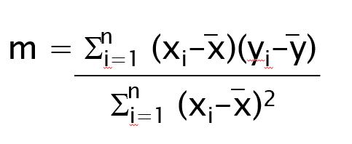
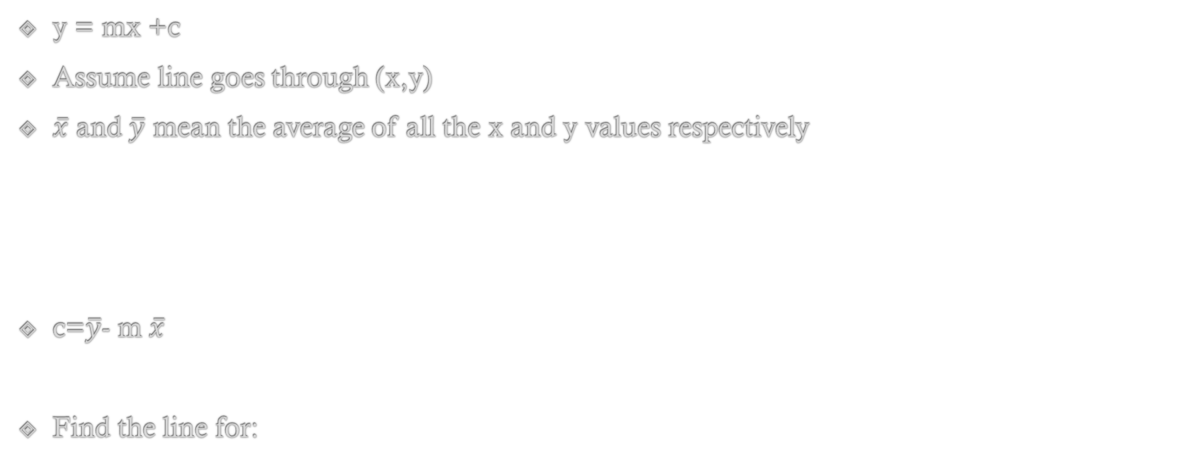
Linear Least Squares Estimate
y = mx +c
Assume line goes through (x,y)
$\overline{x}$ and $\overline{y}$ mean the average of all the x and y values respectively
c=$\overline{y}$- m $\overline{x}$
Find the line for:
x | 2.1 | 3.4 | 4.2 | 4.5 | 5.5 | 1.1 | 3.8
y | 1.1 | 2.7 | 3.8 | 4.1 | 4.2 | 0.8 | 3.9
Notes:
https://towardsdatascience.com/linear-regression-using-least-squares-a4c3456e8570

Slide 24
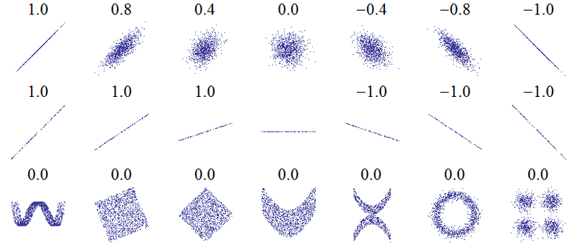
Pearson Correlation Coefficient
How strong is the relationship between two variables as a number in [-1.0, 1.0]
A measure of the linear correlation between two variables X and Y
from wikipedia

Slide 25
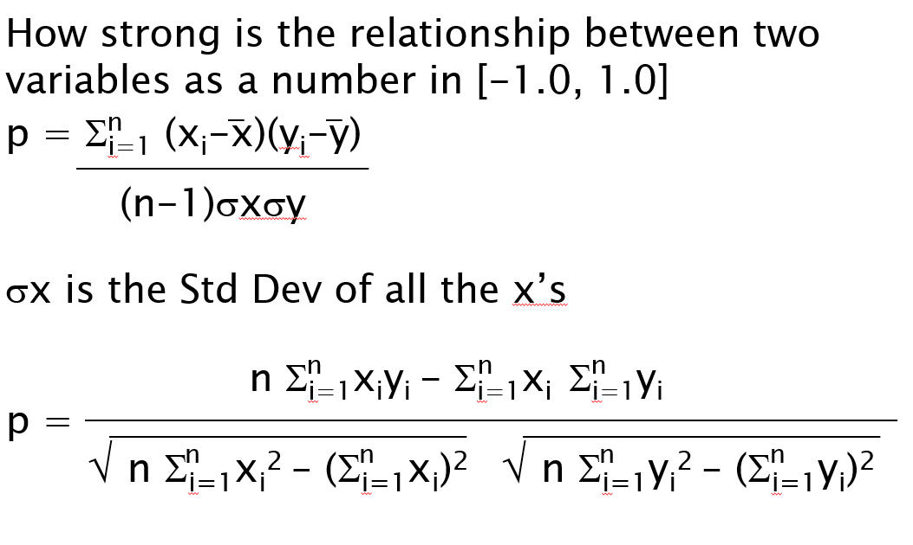
Pearson Correlation Coefficient

Slide 26
Pearson Correlation Coefficient
Calculate the correlation coefficient for:
Wiki
x | 2.1 | 3.4 | 4.2 | 4.5 | 5.5 | 1.1 | 3.8
y | 1.1 | 2.7 | 3.8 | 4.1 | 4.2 | 0.8 | 3.9

Slide 27
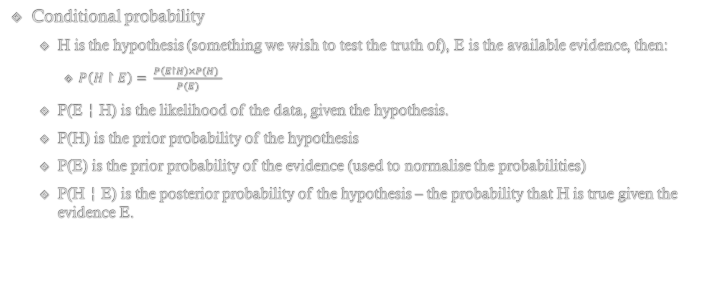
Bayes’ Theorem
Conditional probability
H is the hypothesis (something we wish to test the truth of), E is the available evidence, then:
$P\left(H↾E\right)= \frac{P\left(E↾H\right)×P(H) }{P(E)}$
P(E ¦ H) is the likelihood of the data, given the hypothesis.
P(H) is the prior probability of the hypothesis
P(E) is the prior probability of the evidence (used to normalise the probabilities)
P(H ¦ E) is the posterior probability of the hypothesis – the probability that H is true given the evidence E.

Slide 28
This week’s labs
Practise the maths
Further maths tutorial on LZ… make sure to be able to do all the maths!
Review Python coding using the Jupyter notebook in the 'Learning Materials/Introduction to Python' folder

